Slide 1
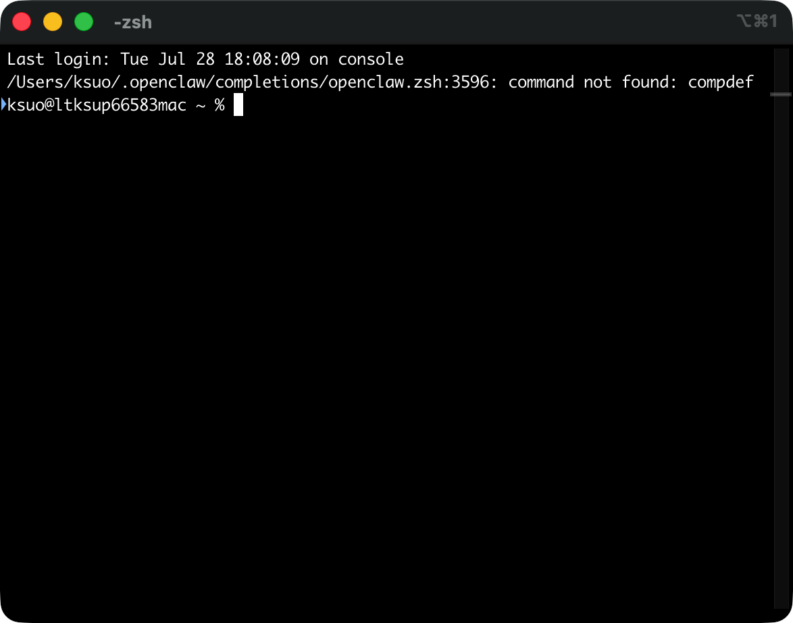
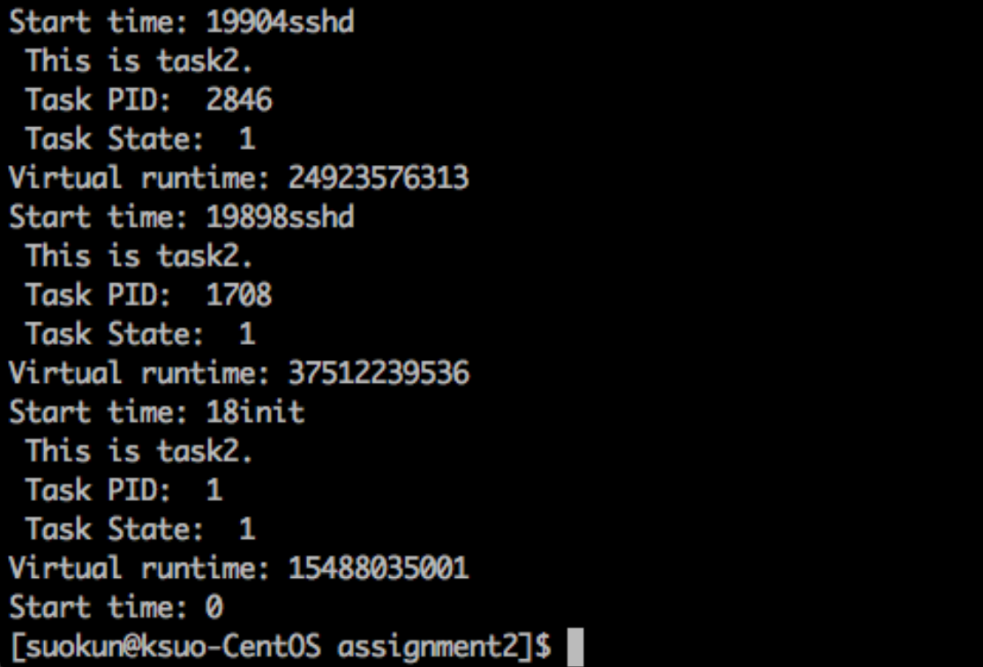

Start time
Process ID
PID 1708 is parent process of 2846
Virtual time
Running state
PID 1 is parent process of 1708
Name

